Slide 1

Banking Data Analytics
Group 3
Monali Rajendra Kadhane
Swapnil Sharad Kulkarni
Siddhesh Suhas Kamble
Mohita Dashora
AHMED MOHAMED ALHASSAN ABASHAR

Slide 2
Index
Project Overview
Insights
Data Cleaning
Excel Dashboard Power BI Dashboard Tableau Dashboard MySql Conclusion

Slide 3

Project overview
Evaluate loan portfolio performance by state, product type, and customer grade.
Analyze credit and debit transaction behavior across branches.
Identify high-risk patterns and default tendencies.
Build interactive dashboards for management review.

Slide 4
Insights
Debit and Credit banking data
(Transaction Data)
Bank Data Analytics (Loan Data)
Personal loans are the most common loan type, especially among customers aged 25–35.
2.Bihar ,Punjab and Utter Pradesh has the highest loan amount which is together around 44% of total loan amount.
3.Loans marked as "Not Verified" or "Charged Off" have a significantly higher risk profile.
4.Highest loan Disbursements in 2019 which is Approximately 418M .Drop sudden in 2020 to 60M (Probably because of Pandamic ).
The credit to debit ratio is 1.2, suggesting a net positive cash flow.
Online transfers dominate transaction modes, while cash-heavy branches may signal risk.
Some branches show abnormally high transaction volume, requiring further audit.
A few accounts perform over 10 transactions daily, raising potential fraud flags.

Slide 5
Data Cleaning
Bank Data Analytics
Debit and Credit Banking Data
1 | Missing values (e.g. blank cells, especially in financial columns).
2 | Data type mismatches (e.g. numeric fields stored as strings).
3 | Duplicated records (e.g. repeated Account ID or Client id).
4 | Inconsistent formatting (e.g. "36 months" as text vs integer duration).
1 | Date formatting in Transaction Date.
2 | Categorical normalization for Transaction Type, Bank Name, etc.
3 | Duplicate transactions based on Customer ID, Transaction Date, Amount.

Slide 6
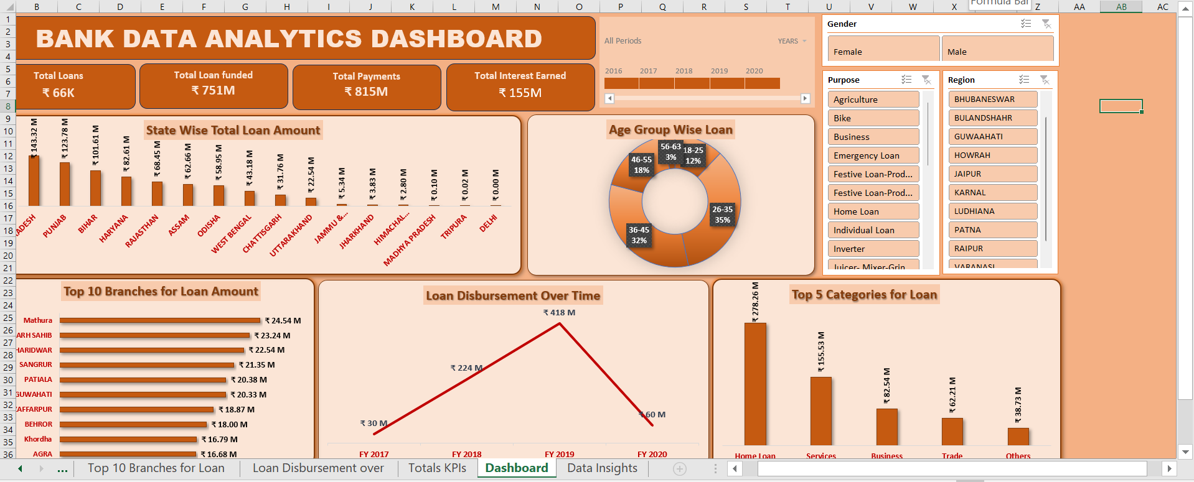

Excel Dashboard

Slide 7
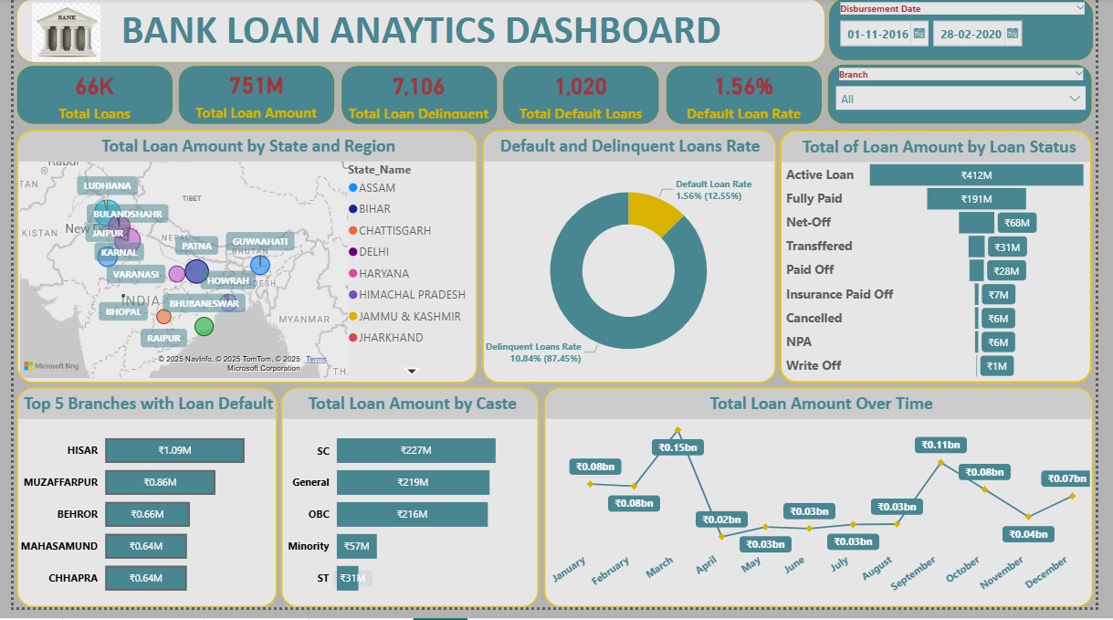

Power BI

Slide 8
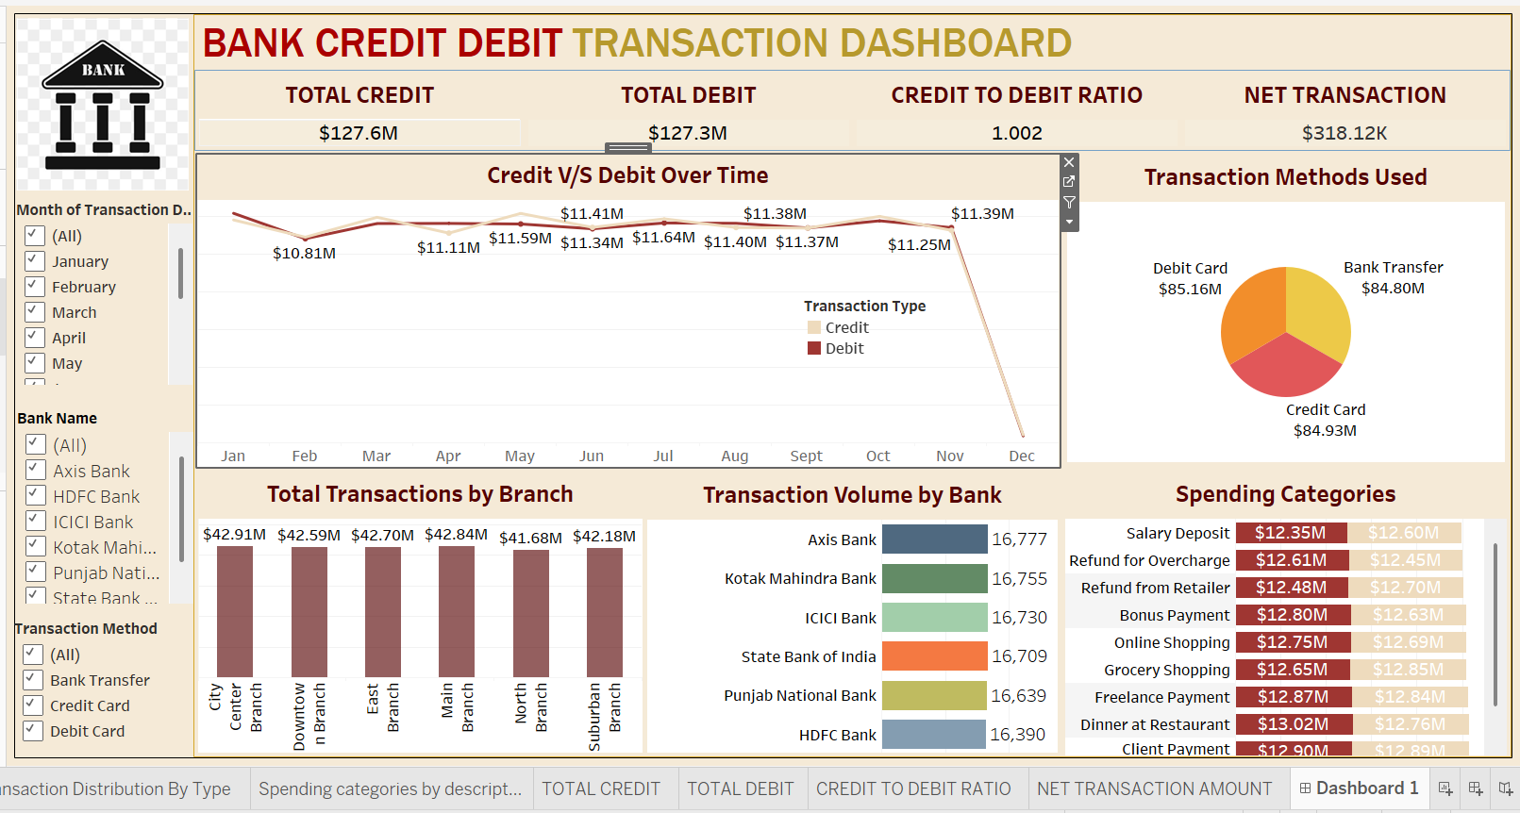

Tableau

Slide 9
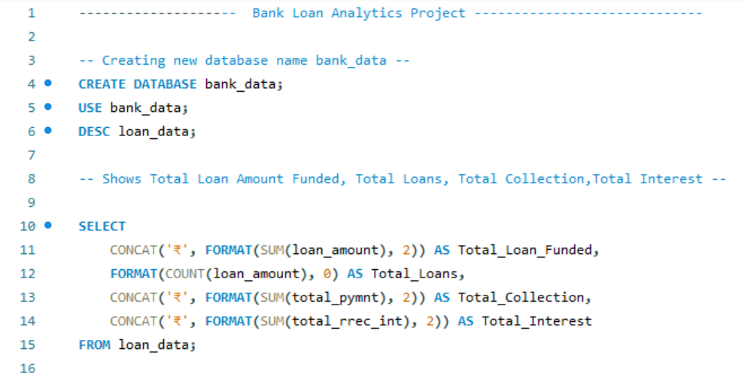
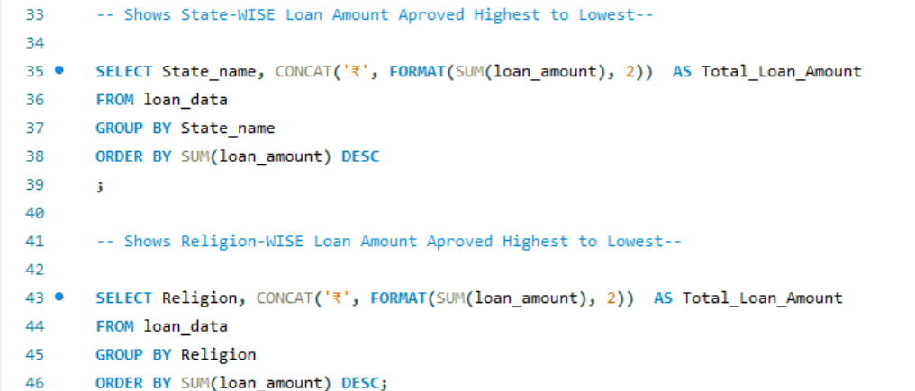
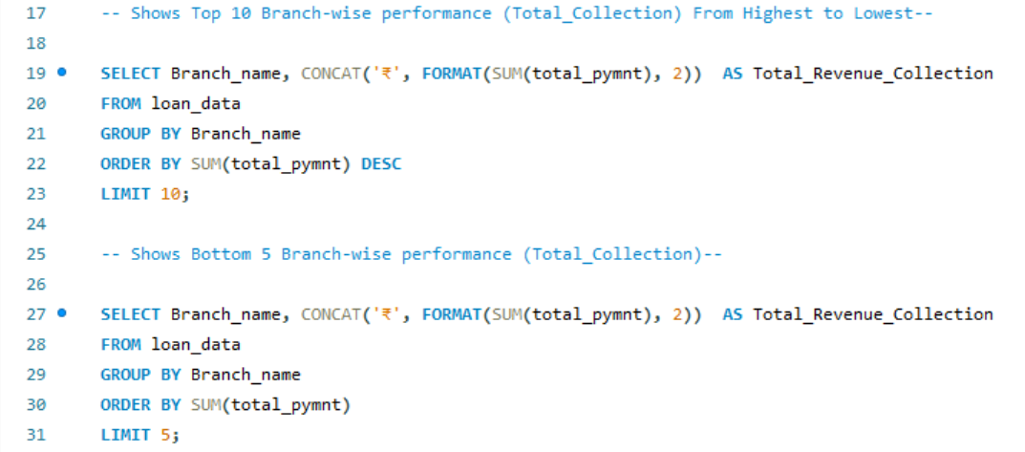
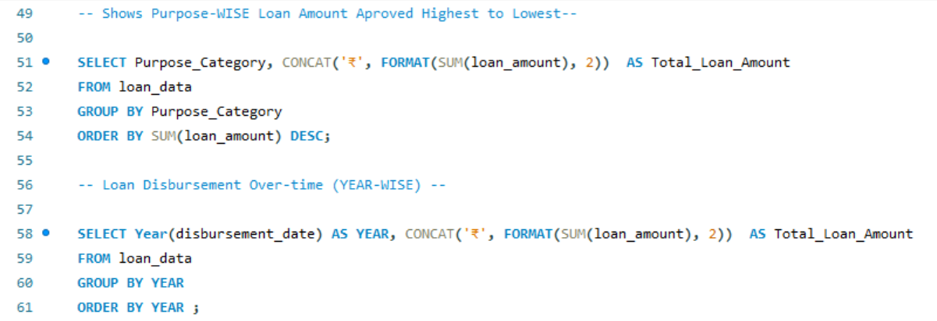


Slide 10
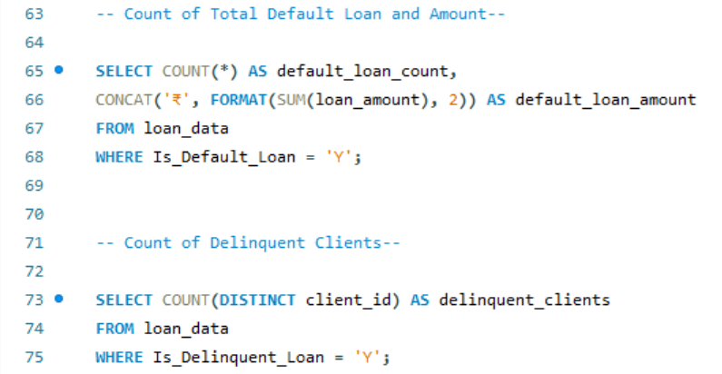
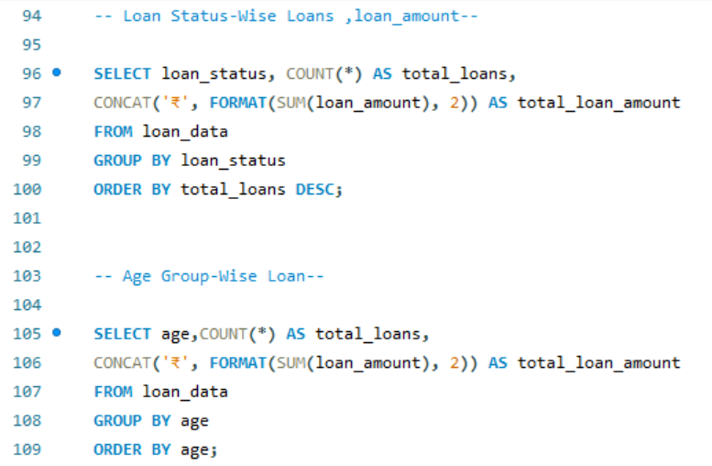
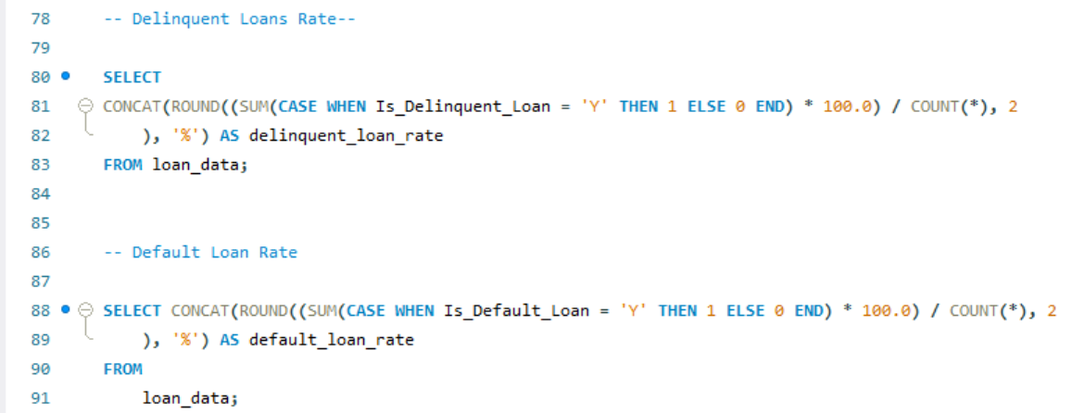
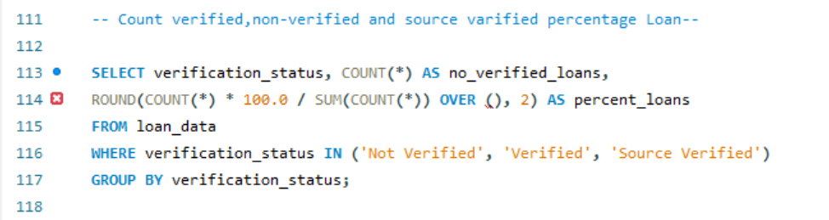


Slide 11
Conclusion
This project utilized banking data to extract meaningful insights into loan performance and customer transactions using Excel, SQL, Tableau, and Power BI.
Loan Analysis revealed:
High volume of personal loans among customers aged 25–40.
Elevated default risk in Grade C or lower borrowers and unverified accounts.
Transaction Analysis showed:
A positive net cash flow (credit > debit) across branches.
Certain branches and accounts flagged for unusually high activity, suggesting risk.
The dashboards built allow real-time KPI tracking and support data-driven decisions.
Overall, the project highlights how analytics can enhance financial performance, mitigate risk, and improve operational focus.

Slide 12


